Slide 1
Session 02 : Android Components
Module 4.3 : Android

Slide 2
Learning Objectives
At the end of the session successful participants will be able to
Understand following Android components
Intent
Service
Intent Filters
Activity
Broadcast Receiver
Manifest xml File

Slide 3
Android Components
Following are IMP Android components
Intent
Service
Intent Filters
Activity
Broadcast Receiver
Manifest xml File

Slide 4
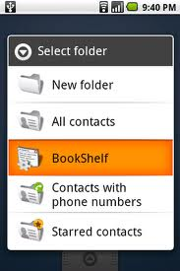
Android Components
Inside Android: Intents
An Intent in Android describes what you want to do.
This may look like:
“I want to look up a contact record,” or
“Please launch this website,” or
“Show the Order Confirmation Screen.”
Intents are important because they facilitate navigation and represent the most important aspect of Android coding.

Slide 5
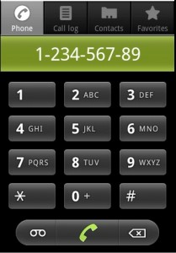
Android Components
Intents & IntentFilters
An Intent is a declaration of need.
An Intent is made up of various pieces including:
Desired action or service,
Data, and
Category of component that should handle the intent and instructions on how to launch a target activity

Slide 6
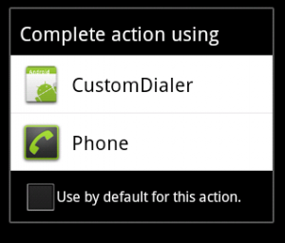
Android Components
Intents & IntentFilters
An IntentFilter is a trigger, a declaration of capability and interest in offering assistance to those in need.
An IntentFilter may be generic or specific with respect to which Intents it offers to service.

Slide 7
Android Components
Intents & IntentFilters
An intent is an abstract description of an operation to be performed.
Its most significant use is in the launching of activities, where it can be thought of as the glue between activities.
The primary pieces of information in an intent are:
Action | Data
The general action to be performed, such as: ACTION_VIEW, ACTION_EDIT, ACTION_MAIN, etc. | The data to operate on, such as a person record in the contacts database, expressed as a Uri.

Slide 8
Android Components
Intents & IntentFilters
Some examples of Intent’s action/data pairs are:
ACTION_VIEWcontent://contacts/1 -- Display information about the person whose identifier is "1".
ACTION_DIALcontent://contacts/1 -- Display the phone dialer with the person filled in.
ACTION_VIEWtel:123 -- Display the phone dialer with the given number filled in
ACTION_DIAL tel:123 -- Display the phone dialer with the given number filled in.
ACTION_EDITcontent://contacts/1 -- Edit information about the person whose identifier is "1".
ACTION_VIEWcontent://contacts/ -- Display a list of people, which the user can browse through.

Slide 9
Android Components
Dissecting Intents
Component name:
The name of the component that should handle the intent ( for example "com.example.project.app.MyActivity1" )
Action:
A string naming the action to be performed —or, in the case of broadcast intents, the action that took place and is being reported (for example: ACTION_VIEW, ACTION_CALL, ACTION_TIMEZONE_CHANGED, … )

Slide 10
Android Components
Dissecting Intents
Data:
The URI of the data to be acted on and the MIME type of that data (for example tel:/216 555-1234, "http://maps.google.com”, ... ).
Category:
A string containing additional information about the kind of component that should handle the intent (for example CATEGORY_BROWSABLE, CATEGORY_LAUNCHER, … )

Slide 11
Android Components
Dissecting Intents
Extra:
Key-value pairs for additional information that should be delivered to the component handling the intent
Flags:
Flags of various sorts.

Slide 12
Android Components
Delivering Intents
An Intent object is passed to
Context.startActivity() or Activity.startActivityForResult() to launch an activity or get an existing activity to do something new (asynchronous & synchronously respectively)
An Intent object is passed to Context.startService()to initiate a service or deliver new instructions to an ongoing service.
An intent can be passed to Context.bindService()to establish a connection between the calling component and a target service. It can optionally initiate the service if it's not already running.

Slide 13
Android Components
Intent Resolution
Intents can be divided into two groups:
Explicit Intent
Implicit Intent

Slide 14
Android Components
Intent Resolution
Explicit Intents:
Explicit intents designate the target component by its name, typically used for an activity starting a subordinate service or launching a sister activity.

Slide 15
Android Components
Intent Resolution
Explicit Intents:
Implicit intents do not name a target (the field for the component name is blank). Implicit intents are often used to activate components in other applications. Late binding applies. Whenever possible Android delivers an explicit intent to an instance of the designated target class.

Slide 16
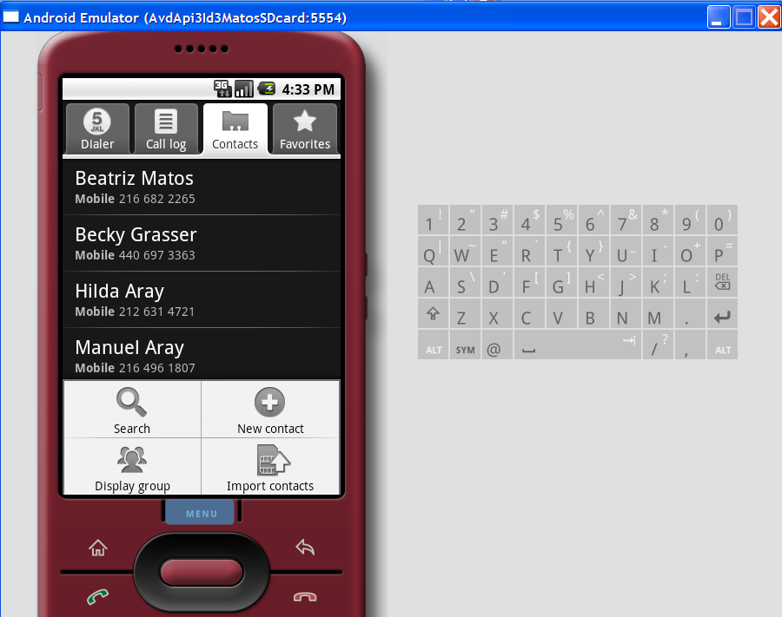
Android Components
Example: Intent 1
Following fragments calls an Intent whose job is to invoke a built-in task (ACTION_VIEW) and explore the Contacts available in the phone.
Intent myIntent= new Intent(
Intent.ACTION_VIEW,
Uri.parse("content://contacts/people"));
startActivity(myIntent);

Slide 17
Android Components
Example: Intent 1
Intent uses ACTION_VIEW to see Contacts.

Slide 18
Android Components
Example: Intent 1
Complete code to see contacts
package matos.cis493;
import android.app.Activity;
import android.content.Intent;
import android.net.Uri;
import android.os.Bundle;
public class AndDemo1 extends Activity {
/** show contact list */ @Override
public void onCreate(Bundle savedInstanceState) {
super.onCreate(savedInstanceState);
setContentView(R.layout.main);
Intent myIntent= new Intent (Intent.ACTION_VIEW,Uri.parse("content://contacts/people"));
startActivity(myIntent);}}

Slide 19
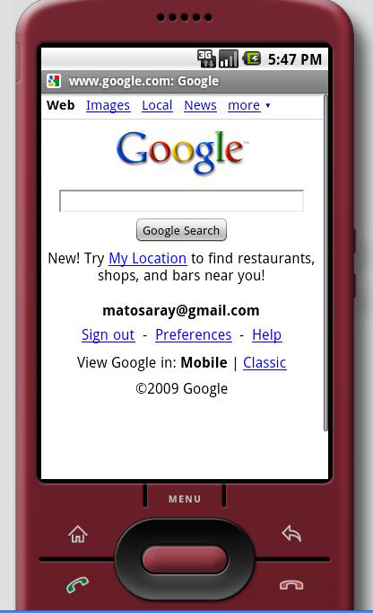
Android Components
Example: Intent 2
Following Intent uses built-in task (ACTION_VIEW) to explore a web page (see new Uri value)
Intent myIntent= new Intent(
Intent.ACTION_VIEW,
Uri.parse("http://www.google.com"));
startActivity(myIntent);

Slide 20
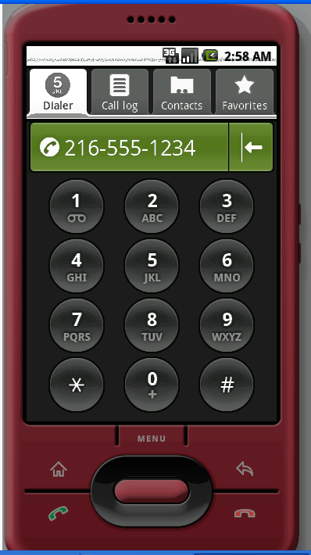
Android Components
Example: Intent 3
Following Intent uses built-in task (ACTION_VIEW) to make a phone call (see new Uri value)
Intent myIntent= new Intent(
Intent.ACTION_VIEW,
Uri.parse("tel:/216 555-1234"));
startActivity(myIntent);

Slide 21
Android Components
IntentFilters
The IntentFilter defines the relationship between the Intent and the application.
IntentFilters can be specific to the data portion of the Intent, the action portion, or both.
IntentFilters also contain a field known as a category. A category helps classify the action.
For example, the category named
CATEGORY_LAUNCHER
Instructs Android that the Activity containing this IntentFilter should be visible in the home screen.

Slide 22
Android Components
IntentFilters
When an Intent is dispatched, the system evaluates the available Activities, Services, and registered BroadcastReceivers and routes the Intent to the most appropriate recipient.

Slide 23
Android Components
IntentFilters
Intents are distributed to Android applications, which register themselves by way of the IntentFilter, typically in the AndroidManifest.xml file.
For hire: Take a ride on the
Internet (IntentFilter)
For hire: Find anything on
the map! (IntentFilter)
Android Application # 2 (BroadcastReceiver)
startActivity(Intent);
Or
startActivity(Intent, identifier);
Or
startService(Intent);
For hire: View, Edit, Browse any Contacts (IntentFileter)
Android Application # 3 (BroadcastReceiver)
Help me: Take a ride on the Internet
Help me: Find an address
on the map (Intent)
For hire: Custom action on custom data (IntentFileter)
Android Application # 4 (BroadcastReceiver)
Android Application # 1

Slide 24
Android Components
IntentFilters
To inform the system which implicit intents they can handle, activities, services, and broadcast receiver scan have one or more intent filters.
Each filter describes a capability that the component is willing to receive.
An explicit intent is always delivered to its target, no matter what it contains; the filter is not consulted.
But an implicit intent is delivered to a component only if it can pass through one of the component's filters.

Slide 25
Android Components
IntentFilters
IntentFilters are often defined in an application’s AndroidManifest.xml with the <intent-filter>tag.
<intent-filter . . . >
<action android:name="code android.intent.action.MAIN" />
<category android:name="code android.intent.category.LAUNCHER" />
<category android:name="android.intent.category.BROWSABLE" />
<data android:type="video/mpeg" android:scheme="http" . . . />
<data android:type="audio/mpeg" android:scheme="http" . . . />
. . .
</intent-filter>

Slide 26

Android Components
Android Applications
Each Android application runs in its own Linux process.
An application consists of a combination of software components including:
Activities
Services
Broadcast Receivers
Content Providers

Slide 27
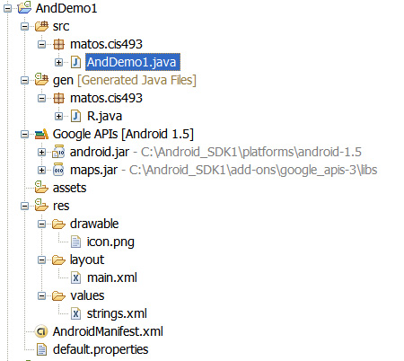
Android Components
Android Applications
Structure of a typical Android Application
Activities, Services, BroadcastReceivers, ContentProviders, Go Here
Resources
Manifest

Slide 28
Android Components
Android Services
A Service is an application component that runs in the background, not interacting with the user, for an indefinite period of time.
Each service class must have a corresponding <service> declaration in its package's AndroidManifest.xml.
Services can be started/stopped with:
Context.startService()
Context.bindService()
stopService(…)
unbindService(…)

Slide 29
Android Components
Android Services
Services, like other application objects, run in the main thread of their hosting process.
This means that, if your service is going to do any CPU intensive (such as MP3 playback) or blocking (such as networking, RSS exchange) operations, it should spawn its own thread in which to do that work

Slide 30
Android Components
Android Services
Service1 Class
packagematos.service;
importandroid.app.Service;
importandroid.content.Intent;
importandroid.os.IBinder;
importandroid.util.Log;
publicclassService1 extendsService implementsRunnable{
privateintcounter= 0;
@Override
publicvoidonCreate() {
super.onCreate();
Thread aThread= newThread(this);
aThread.start(); }

Slide 31
Android Components
Android Services
Service1 Class
publicvoidrun() {
while(true) {
try{
Log.i("service1", "service1 firing : # "+ counter++);
Thread.sleep(10000); //this is where the heavy-duty computing occurs
} catch(Exception ee) {
Log.e("service1", ee.getMessage());
}}}
@Override
publicIBinderonBind(Intent intent) {
Returnnull;}}

Slide 32
Android Components
Android Services
Service1 Driver
package matos.service;
import android.app.Activity;
import android.content.Intent;
import android.os.Bundle;
public class Service1Driverextends Activity {
@Override
public void onCreate(Bundle savedInstanceState) {
super.onCreate(savedInstanceState);
setContentView(R.layout.main);
// invoking the service
Intent service1Intent = new Intent(this, Service1.class );
startService( service1Intent );}}// Service1Driver

Slide 33
Android Components
Android Services
Service1Demo Manifest
<?xml version="1.0" encoding="utf-8"?>
<manifest xmlns:android="http://schemas.android.com/apk/res/android"
package="matos.service"
android:versionCode="1"
android:versionName="1.0">
<application android:icon="@drawable/icon" android:label="@string/app_name">
<activity android:name=".Service1Driver"
android:label="@string/app_name">
<intent-filter>

Slide 34
Android Components
Android Services
Service1Demo Manifest
<action android:name="android.intent.action.MAIN" />
<category android:name="android.intent.category.LAUNCHER" />
</intent-filter>
</activity>
<service android:name="Service1" android:enabled="true" >
</service>
</application>
<uses-sdkandroid:minSdkVersion="3" />
</manifest>

Slide 35
Android Components
Android Services
Debugging – Log Cat
07-01 02:49:46.097: INFO/ActivityManager(583): Displayed activity matos.service/.Service1 Driver
07-01 02:49:51.277: DEBUG/dalvikvm(724): GC freed 1575 objects / 81280 bytes in 138ms
07-01 02:49:55.831: INFO/service1(767): service1 firing:# 1
07-01 02:50:05.839: INFO/service1(767): service1 firing:# 2
07-01 02:50:15.847: INFO/service1(767): service1 firing:# 3
07-01 02:50:25.857: INFO/service1(767): service1 firing:# 452

Slide 36
Android Components
Android Broadcast Receiver
What is Android Broadcast Receiver?
If an application wants to receive and respond to a global event, such as the phone ringing or an incoming text message, it must register as a BroadcastReceiver.
An application registers to receive Intents by announcing in the AndroidManfest.xml file its IntentFilters.

Slide 37
Android Components
Android Broadcast Receiver
Broadcast Receiver & UI
Like Services, BroadcastReceivers do not have a UI.
Of even more importance, the code running in the on Receive method of a BroadcastReceiver should make no assumptions about persistence or long-running operations.
If the BroadcastReceiver requires more than a trivial amount of code execution, it is recommended that the code initiate a request to a Service to complete the requested functionality.

Slide 38
Android Components
Android Broadcast Receiver
Broadcast Receiver
Broadcast Receiver
onReceive(…)
Some Activity
Broadcast Receiver
sendBroadcast(…)
onReceive(…)
Broadcast Receiver
onReceive(…)

Slide 39
Android Components
Android Broadcast Receiver
Intents Vs. Broadcasts
Starting an Activity with an Intent is a foreground operation that modifies what the user is currently interacting with.
Broadcasting an Intent is a background operation that the user is not normally aware of.

Slide 40
Android Components
Android Broadcast Receiver
Types of Broadcasts
Normal Broadcasts
Ordered Broadcasts

Slide 41
Android Components
Android Broadcast Receiver
Normal Broadcasts
Normal broadcasts(sent with sendBroadcast) are completely asynchronous. All receivers of the broadcast are run in an undefined order, often at the same time. This is more efficient, but means that receivers cannot use the result or abort APIs included here.

Slide 42
Android Components
Android Broadcast Receiver
Ordered Broadcasts
Ordered broadcasts(sent with sendOrderedBroadcast) are delivered to one receiver at a time. As each receiver executes in turn, it can propagate a result to the next receiver, or it can completely abort the broadcast so that it won't be passed to other receivers. The order receivers run in can be controlled with the android:priorityattribute of the matching intent-filter; receivers with the same priority will be run in an arbitrary order.

Slide 43
Android Components
Android Broadcast Receiver
Broadcast Receiver Life Cycle
A process that is currently executing a BroadcastReceiver (that is, currently running the code in its onReceive(Context, Intent)method) is considered to be a foreground process and will be kept running by the system except under cases of extreme memory pressure.

Slide 44
Introduction To Android Development
Android Broadcast Receiver
Broadcast Receiver Life Cycle
Once you return from onReceive(), the BroadcastReceiver is no longer active, and its hosting process is only as important as any other application components that are running in it.

Slide 45
Introduction To Android Development
Android Broadcast Receiver
Broadcast Receiver Life Cycle
This means that for longer-running operations you will often use a Service in conjunction with a BroadcastReceiver to keep the containing process active for the entire time of your operation.

Slide 46
Introduction To Android Development
Android Broadcast Receiver
Broadcast Receiver Example: Intercept Arriving SMS
package matos.broadcastreceiver;
import android.content.BroadcastReceiver;
import android.content.Context;
import android.content.Intent;
import android.content.IntentFilter;
import android.util.Log;
import android.app.Activity;
import android.os.Bundle;
public class MySMSMailBoxextends Activity {
// intercepts reception of new text-messages

Slide 47
Introduction To Android Development
Android Broadcast Receiver
Broadcast Receiver Example: Intercept Arriving SMS
@Override
public void onCreate(Bundle savedInstanceState) {
super.onCreate(savedInstanceState);
setContentView(R.layout.main);
// define instance of local broadcast receiver
MySMSMailBoxReceivermySmsReceiver= new MySMSMailBoxReceiver();
// receiver's filter will accept event: ...SMS_RECEIVED
IntentFilterfilter = new IntentFilter(
"android.provider.Telephony.SMS_RECEIVED");
// tell Android OS this receiver is ready to go
registerReceiver(mySmsReceiver, filter);}

Slide 48
Introduction To Android Development
Android Broadcast Receiver
Broadcast Receiver Example: Intercept Arriving SMS
// this is the custom made broadcast receiver. Its onReceivemethod
// is fired when the filter matches the SMS_RECEIVED event
public class MySMSMailBoxReceiverextendsBroadcastReceiver{
public static final String tag = "<<< MySMSMailBox>>>";
@Override
public void onReceive(Context context, Intent intent) {
Log.i(tag, "onReceive");
// checking global event signaling arrival of text-message
if (intent.getAction().equals(
"android.provider.Telephony.SMS_RECEIVED")) {

Slide 49
Introduction To Android Development
Android Broadcast Receiver
Broadcast Receiver Example: Intercept Arriving SMS
Log.i(tag, "Found our SMS Event!");
// you have intercepted the SMS
// do something interesting with it. Bye!
}
}// onReceive
} // BroadcastReceiver
}

Slide 50
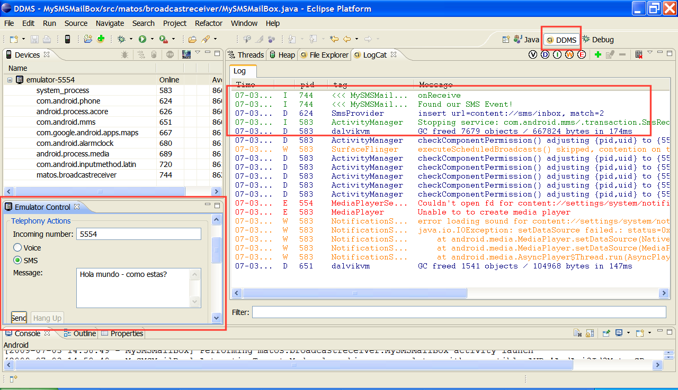
Introduction To Android Development
Android Broadcast Receiver
Broadcast Receiver Example: Intercept Arriving SMS

Slide 51
Introduction To Android Development
Android Broadcast Receiver
Broadcast Receiver Example: Intercept Arriving SMS
<?xml version="1.0" encoding="utf-8"?>
<manifest xmlns:android="http://schemas.android.com/apk/res/android"
package="matos.broadcastreceiver"
android:versionCode="1"
android:versionName="1.0">
<application android:icon="@drawable/icon" android:label="@string/app_name">
<activity android:name=".MySMSMailBox"
android:label="@string/app_name">
<intent-filter>
<action android:name="android.intent.action.MAIN" />

Slide 52
Introduction To Android Development
Android Broadcast Receiver
Broadcast Receiver Example: Intercept Arriving SMS
<category android:name="android.intent.category.LAUNCHER" />
</intent-filter>
</activity>
</application>
<uses-permission android:name="android.permission.RECEIVE_SMS" />
<receiver android:name="MySMSMailBoxReceiver" >
<intent-filter>
<action
android:name= "android.provider.Telephony.SMS_RECEIVED"/>
</intent-filter> </receiver>
<uses-sdkandroid:minSdkVersion="3" /> </manifest>

Slide 53
Introduction To Android Development
Android Content Provider
Content providers store and retrieve data and make it accessible to all applications.
They are the only way to share data across Android applications. There's no common storage area that all Android packages can access.
Android ships with a number of content providers for common data types (audio, video, images, personal contact information, and so on).

Slide 54
Introduction To Android Development
Android Content Provider
Content Providers are a data layer providing data abstraction for its clients and centralizing storage and retrieval routines in a single place.
Content Provider may provide data to an Activity or Service in the same application’s space as well as an Activity or Service contained in other applications.
A Content Provider may use any form of data storage mechanism available on the Android platform, including files, SQLite databases, or even a memory-based hash map if data persistence is not required.

Slide 55
Introduction To Android Development
Android Content Provider
It is the data tier for Android applications and is the prescribed manner in which data is accessed and shared on the device.
Android Application #3
Activity 3.1
Android Application #1
Activity 3.1
Android Application #2
ContentProvider A
Activity 2.1
Activity 3.1
SQLite
Data File
XML
Virtual Connection To Remote Store

Slide 56
Introduction To Android Development
Android Content Provider
The data model:
Content providers expose their data as a simple table on a database model, where each row is a record and each column is data of a particular type and meaning.
For example, information about people and their phone numbers might be exposed as follows:
_ID | Number | Number_Key | Label | Name | Type
13 | 555 6677 | 425 555 6677 | Kirkland Office | Bully Pulpit | TYPE_WORK
44 | (212) 555-1234 | 212 555 1234 | NY apartment | Alan Vain | TYPE_HOME
45 | (212) 555-6657 | 212 555 6657 | Downtown office | Alan Vain | TYPE_MOBILE
53 | 201.555.4433 | 201 555 4433 | Love Nest | Rex Cars | TYPE_HOME

Slide 57
Introduction To Android Development
Android Content Provider
URIs
Each content provider exposes a public URI that uniquely identifies its data set.
A content provider that controls multiple data sets (multiple tables) exposes a separate URI for each one.
All URIs for providers begin with the string "content://".

Slide 58
Introduction To Android Development
Android Content Provider
URIs
Android defines CONTENT_URI constants for all the providers that come with the platform. For example:
android.provider.Contacts.Phones.CONTENT_URIandroid.provider.Contacts.Photos.CONTENT_URI
android.provider.CallLog.Calls.CONTENT_URIandroid.provider.Calendar.CONTENT_URI
The ContentResolver method takes an URI as its first argument. It's what identifies which provider the ContentResolver should talk to and which table of the provider is being targeted.

Slide 59
Introduction To Android Development
Android Content Provider
Querying a Content Provider
You need three pieces of information to query a content provider:
The URI that identifies the provider
The names of the data fields you want to receive
The data types for those fields
If you're querying a particular record, you also need the ID for that record.
A query returns a Cursor object that can move from record to record & column to column to read the contents of each field. It has specialized methods for reading all type of data.

Slide 60
Introduction To Android Development
Android Content Provider
Querying a Content Provider:
Example – Posting a query to contact list
package matos.cis493;
import android.app.Activity;
import android.net.Uri;
import android.os.Bundle;
import android.widget.EditText;
import android.widget.Toast;
import android.provider.Contacts.People;
import android.content.ContentUris;
import android.database.Cursor;
public class AndDemo1 extends Activity {
/** queries contact list */

Slide 61
Introduction To Android Development
Android Content Provider
Querying a Content Provider:
Example – Posting a query to contact list
@Override
public void onCreate(Bundle savedInstanceState) {
super.onCreate(savedInstanceState);
setContentView(R.layout.main);
// Use the ContentUrismethod to produce the base URI for the contact with _ID == 23.
Uri myPerson1 = ContentUris.withAppendedId(People.CONTENT_URI, 23);
// use the "people" content provider to explore all your contacts
Uri myPerson2 = Uri.parse("content://contacts/people");

Slide 62
Introduction To Android Development
Android Content Provider
Querying a Content Provider:
Example – Posting a query to contact list
// Then query for this specific record using method: managedQuery
// args: (Uri uri, String[] projection, String selection,
// String[] selectionArgs, String sortOrder)
Cursor cur = managedQuery(myPerson2, null, null, null, null);
// do something with the cursor here
}
}

Slide 63
Introduction To Android Development
Android Content Provider
Querying a Content Provider:
Example – Posting a query to contact list
<?xml version="1.0" encoding="utf-8"?>
<manifest xmlns:android="http://schemas.android.com/apk/res/android"
package="matos.cis493"
android:versionCode="1"
android:versionName="1.0">
<application android:icon="@drawable/icon" android:label="@string/app_name">
<activity android:name=".AndDemo1"
android:label="@string/app_name">
<intent-filter>

Slide 64
Introduction To Android Development
Android Content Provider
Querying a Content Provider:
Example – Posting a query to contact list
<action android:name="android.intent.action.MAIN" />
<category android:name="android.intent.category.LAUNCHER" />
</intent-filter>
</activity>
</application>
<uses-sdkandroid:minSdkVersion="3" />
<uses-permission android:name="android.permission.READ_CONTACTS">
</uses-permission>
</manifest>

Slide 65
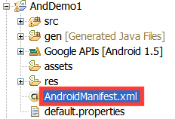
Introduction To Android Development
Android Manifest xml File
Every application must have an AndroidManifest.xml file
(with precisely that name) in its root directory.
The manifest presents essential information about the application to the Android system, information the system must have before it can run any of the application's code.

Slide 66
Introduction To Android Development
Android Manifest xml File
These are the only legal elements; you cannot add your own elements or attributes.
<action> <activity> <activity-alias> <application> <category> <data> <grant-uri-permission> <instrumentation> <intent-filter> <manifest> <meta-data> | <permission> <permission-group> <permission-tree> <provider> <receiver> <service> <uses-configuration> <uses-library> <uses-permission> <uses-sdk>

Slide 67
Introduction To Android Development
Android Manifest xml File
Among other things, the manifest does the following:
It names the Java package for the application. The package name serves as a unique identifier for the application.
It describes the components of the application —the activities, services, broadcast receivers, and content providers that the application is composed of.
It names the classes that implement each of the components and publishes their capabilities (for example, which Intent messages they can handle). These declarations let the Android system know what the components are and under what conditions they can be launched.

Slide 68
Introduction To Android Development
Android Manifest xml File
Among other things, the manifest does the following:
It determines which processes will host application components.
It declares which permissions the application must have in order to access protected parts of the API and interact with other applications.
It also declares the permissions that others are required to have in order to interact with the application's components.

Slide 69
Introduction To Android Development
Android Manifest xml File
Among other things, the manifest does the following:
It lists the Instrumentation classes that provide profiling and other information as the application is running. These declarations are present in the manifest only while the application is being developed and tested; they're removed before the application is published.
It declares the minimum level of the Android API that the application requires.
It lists the libraries that the application must be linked against.

Slide 70
Introduction To Android Development
Android Manifest xml File
<?xml version="1.0" encoding="utf-8"?>
<manifest xmlns:android="http://schemas.android.com/apk/res/android"
package="matos.earthquake"
android:versionCode="1"
android:versionName="1.0.0">
<application android:icon="@drawable/yellow_circle" android:label="@string/app_name">
<activity android:name=".AndQuake"
android:label="@string/app_name">
<intent-filter>
<action android:name="android.intent.action.MAIN" />
<category android:name="android.intent.category.LAUNCHER" />
</intent-filter>
</activity>

Slide 71
Introduction To Android Development
Android Manifest xml File
<activity android:name=".SatelliteMapping"></activity>
<service android:name="AndQuakeService" android:enabled="true" >
</service>
<receiver android:name="AndQuakeAlarmReceiver" >
<intent-filter>
<action
android:name= "ALARM_TO_REFRESH_QUAKE_LIST"/>
</intent-filter>
</receiver>
</application>
<uses-library android:name="com.google.android.maps" />
<uses-permission android:name="android.permission.INTERNET" />
</manifest>

Slide 72
Introduction To Android Development
Android Manifest xml File
Example: Currency Converter
Implementing a simple currency converter:
USD –Euro –Colon (CR)
Note: Naive implementation using the rates
1 Costa Rican Colon = 0.001736 U.S. dollars
1 Euro = 1.39900 U.S. dollars

Slide 73
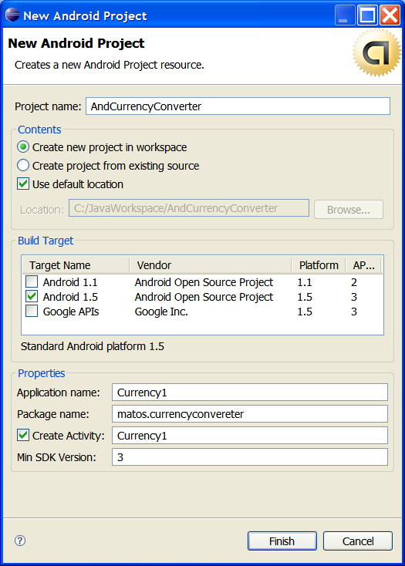
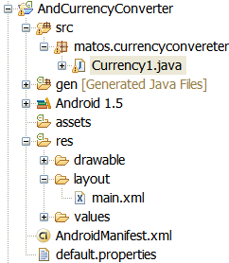
Introduction To Android Development
Android Manifest xml File
Example: Currency Converter

Slide 74
Introduction To Android Development
Android Manifest xml File
Example: Currency Converter
packagematos.currencyconvereter;
importandroid.app.Activity;
importandroid.os.Bundle;
importandroid.view.View;
importandroid.view.View.OnClickListener;
importandroid.widget.Button;
importandroid.widget.EditText;
importandroid.widget.Toast;
publicclassCurrency1 extendsActivity {
// naive currency converter from USD to Euros & Colones
finaldoubleEURO2USD= 1.399;
finaldoubleCOLON2USD= 0.001736;

Slide 75
Introduction To Android Development
Android Manifest xml File
Example: Currency Converter
// GUI widgets
Button btnConvert;
Button btnClear;
EditTexttxtUSDollars;
EditTexttxtEuros;
EditTexttxtColones;
@Override
publicvoidonCreate(Bundle savedInstanceState) {
super.onCreate(savedInstanceState);
setContentView(R.layout.main);
// bind local controls to GUI widgets

Slide 76
Introduction To Android Development
Android Manifest xml File
Example: Currency Converter
txtUSDollars= (EditText)findViewById(R.id.txtUSDollars);
txtUSDollars.setHint("Enter US dollars");
txtEuros= (EditText)findViewById(R.id.txtEuros);
txtColones= (EditText)findViewById(R.id.txtColones);
// attach click behavior to buttons
btnClear= (Button)findViewById(R.id.btnClear);
btnClear.setOnClickListener(newOnClickListener() {
// clear the text boxes
@Override
publicvoidonClick(View v) {
txtColones.setText(""); txtEuros.setText("");
txtUSDollars.setText("");}});

Slide 77
Introduction To Android Development
Android Manifest xml File
Example: Currency Converter
// do the conversion from USD to Euros and Colones
btnConvert= (Button) findViewById(R.id.btnConvert);
btnConvert.setOnClickListener(newOnClickListener() {
@Override
publicvoidonClick(View v) {
try{
String usdStr= txtUSDollars.getText().toString();
doubleusd= Double.parseDouble( usdStr);
String euros= String.valueOf( usd/ EURO2USD);
String colones= String.valueOf( usd/ COLON2USD);
txtEuros.setText(euros);

Slide 78
Introduction To Android Development
Android Manifest xml File
Example: Currency Converter
txtColones.setText(colones);
} catch(Exception e) {
Toast.makeText(v.getContext(), "Invalid data -try again", Toast.LENGTH_SHORT).show();
}
}
});// setOnClick...
}// onCreate
}// class

Slide 79
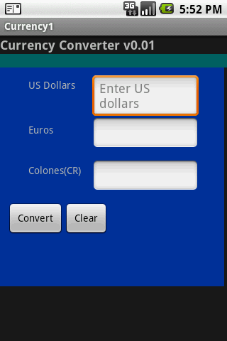
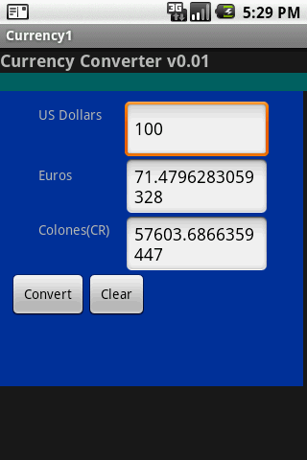
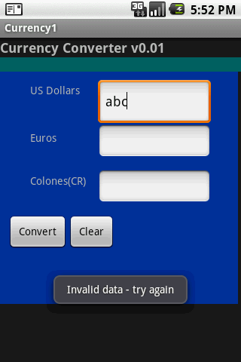
Introduction To Android Development
Android Manifest xml File
Example: Currency Converter

Slide 80
Introduction To Android Development
Android Manifest xml File
Example: Currency Converter
<?xmlversion="1.0"encoding="utf-8"?>
<LinearLayout android:id="@+id/widget47"
android:layout_width="fill_parent"
android:layout_height="fill_parent"
android:orientation="vertical"
xmlns:android="http://schemas.android.com/apk/res/android" >
<TextView android:id="@+id/caption1"
android:layout_width="fill_parent"
android:layout_height="wrap_content"
android:text="Currency Converter v0.01"
android:textSize="18sp"
android:textStyle="bold“ > </TextView>

Slide 81
Introduction To Android Development
Android Manifest xml File
Example: Currency Converter
<TextView
android:id="@+id/greenFiller1"
android:layout_width="fill_parent"
android:layout_height="wrap_content"
android:background="#ff006666"
> </TextView>
<AbsoluteLayout android:id="@+id/absLayout"
android:layout_width="316px"
android:layout_height="308px"
android:background="#ff003399"
>

Slide 82
Introduction To Android Development
Android Manifest xml File
Example: Currency Converter
<TextView
android:id="@+id/greenFiller1"
android:layout_width="fill_parent"
android:layout_height="wrap_content"
android:background="#ff006666"
>
</TextView>
<AbsoluteLayout
android:id="@+id/absLayout"
android:layout_width="316px"
android:layout_height="308px"
android:background="#ff003399"
>

Slide 83
Introduction To Android Development
Android Manifest xml File
Example: Currency Converter
<TextView android:id="@+id/usdCaption"
android:layout_width="wrap_content"
android:layout_height="wrap_content"
android:text="US Dollars"
android:layout_x="40px"
android:layout_y="15px“ > </TextView>
<EditText android:id="@+id/txtUSDollars"
android:layout_width="150px"
android:layout_height="wrap_content"
android:layout_x="130px"
android:layout_y="10px"
> </TextView>

Slide 84
Introduction To Android Development
Android Manifest xml File
Example: Currency Converter
<EditText android:id="@+id/txtEuros"
android:layout_width="150px"
android:layout_height="wrap_content“
android:layout_x="130px"
android:layout_y="70px"
> </EditText>
<TextView android:id="@+id/colonCaption"
android:layout_width="wrap_content"
android:layout_height="wrap_content"
android:text="Colones(CR)"
android:layout_x="40px"
android:layout_y="135px“ > </TextView>

Slide 85
Introduction To Android Development
Android Manifest xml File
Example: Currency Converter
<EditText
android:id="@+id/txtColones"
android:layout_width="150px"
android:layout_height="wrap_content“
android:layout_x="130px"
android:layout_y="130px“ > </EditText>
<Button android:id="@+id/btnConvert"
android:layout_width="wrap_content"
android:layout_height="wrap_content"
android:text=" Convert "
android:layout_x="10px"
android:layout_y="190px“ > </Button>

Slide 86
Android Components
Android Manifest xml File
Example: Currency Converter
<Button
android:id="@+id/btnClear"
android:layout_width="wrap_content"
android:layout_height="wrap_content"
android:text=" Clear "
android:layout_x="90px"
android:layout_y="190px"
>
</Button>
</AbsoluteLayout>
</LinearLayout>

Slide 87
Android Components
Android Manifest xml File
Example: Currency Converter
<?xml version="1.0" encoding="utf-8"?>
<manifest xmlns:android="http://schemas.android.com/apk/res/android"
package="matos.currencyconvereter"
android:versionCode="1"
android:versionName="1.0">
<application android:icon="@drawable/icon" android:label="@string/app_name">
<activity android:name=".Currency1"
android:label="@string/app_name">
<intent-filter>

Slide 88
Android Components
Android Manifest xml File
Example: Currency Converter
<action android:name="android.intent.action.MAIN" />
<category android:name="android.intent.category.LAUNCHER" />
</intent-filter>
</activity>
</application>
<uses-sdkandroid:minSdkVersion="3" />
</manifest>

